Slide 1
How Lifestyle Factors Affect Reaction Time
REM-Coders
Cody Krawczyk and Max Higgins
Namrata Saha
Fall 2025

Slide 2
Why This Matters
Many students experience poor sleep, stress, and inconsistent routines.
Reaction time is a measurable outcome that may reflect cognitive functioning and well-being.
  “Research indicates that fast reaction time is important in many sports, but the effect of fatigue has shown negative, null, or even positive influences on reaction time.” - Acute fatigue affects reaction times and reaction consistency in Mixed Martial Arts fighters.
Understanding what factors most strongly influence performance may help students improve study habits or health.
Notes:
We chose this problem because reaction time is connected to cognitive functioning, and many students deal with poor sleep, stress, and irregular routines. Research shows mixed results on how fatigue impacts reaction time. Sometimes it’s slower, sometimes unchanged, and sometimes even improved in certain contexts like sports. So we wanted to examine lifestyle variables such as stress, sleep, and caffeine to see which ones mattered most. Understanding this could help students make healthier choices and improve cognitive performance.

Slide 3
Project Overview
Our goal is to find features that meaningfully relate to reaction time and use them to build a predictive model. The features we are considering are common associations linked with cognitive score, such as stress level, amount of sleep, age, caffeine intake, etc. Below, we outlined the route we took to reach our goal, but we ran into some issues in our last step.
Step 1
Step 2
Step 3
Step 4
Clean and Prepare Data
Scale Numerical Features
Train, Test & Model Data
Predict Reaction Time
Drop “output” columns, deal with outliers, change categorical data to numerical values, and make sure there are no NULL values.
Use the StandardScaler library to scale our numerical features.
Split our data into Training and Testing and fit it into a regression model, such as linear or RF.
Use features and our regression model to predict a reaction time.
Notes:
Our goal was to identify features that show meaningful relationships to reaction time and use them to build predictive models. We followed a structured approach:
First, we cleaned and prepared the data by dropping unnecessary columns and converting categorical variables.
Next, we scaled our numerical features and then split our data into training and testing sets.
After that, we applied several regression models, both linear and non-linear to predict reaction time.
Finally, we evaluated the performance of each model to determine which approach worked best.

Slide 4
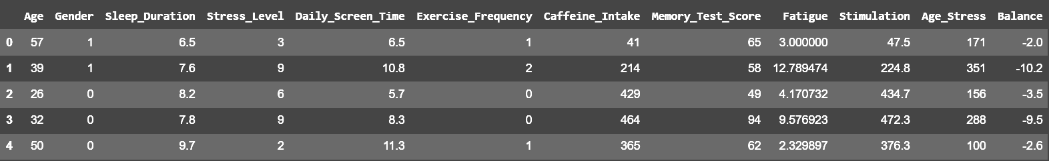
Dataset Information
Our raw dataset is Human Cognitive Performance Analysis, with 13 columns and 80,000 rows. We created a cleaned dataset, with 13 columns and 80,000 rows. Our summary statistics for our dataset is shown below. We felt since reaction time contributes to cognitive score, some of the other features could correlate to reaction time. We wanted to put Reaction Time against the other features, instead of Reaction Time being a feature itself.
Notes:
Our dataset is the Human Cognitive Performance Analysis dataset from Kaggle. It contains 80,000 rows and 13 columns. After cleaning, We removed features like User ID and Diet Type because they didn’t contribute meaningfully to prediction and added 4 columns back in that we created like Fatigue and Stimulation. Reaction Time became our target, and we used the other features as predictors. Since reaction time is part of the dataset’s broader cognitive score metric, we focused specifically on isolating it as our main variable of interest.

Slide 5
Data Preprocessing
To preprocess our data:
Downloaded a CSV file for our dataset.
Removed any null rows.
Dropped any columns that would skew our data.
Removed outliers using the Interquartile Range Method (IQR method).
Added some new engineered features to help our model.
Created a correlation heatmap.
Notes:
We began preprocessing by loading the dataset into Google Colab. We confirmed that there were no null values, which simplified our cleaning process.
Next, we converted categorical features, such as Gender and Exercise Frequency, into numerical values.
We also dropped Cognitive Score and AI Predicted Score since they were intended as targets in the original dataset, and including them would bias our model.

Slide 6
Data Analysis and Insights
In our dataset:
Our target label is Reaction Time
Our key numerical features are Age, Sleep Duration, Stress Level, Daily Screen Time, Caffeine Intake, and Memory Score
Our key categorical Features are Gender (Male, Female, or Other) and Exercise Frequency (Low, Medium or High)
Our next slides shows some visuals that help explain the correlation between our features as well as the spread of our target label.
Notes:
Our target variable is Reaction Time. Our key numerical features included Age, Sleep Duration, Stress Level, Daily Screen Time, Caffeine Intake, and Memory Score Test.
Categorical features included Gender and Exercise Frequency.
On the next slide you’ll see our correlation heatmap, which confirms that most features have extremely weak relationships, and a histogram showing reaction time is evenly distributed. This even distribution is good for modeling, but the lack of correlation suggests weak predictive power overall.

Slide 7
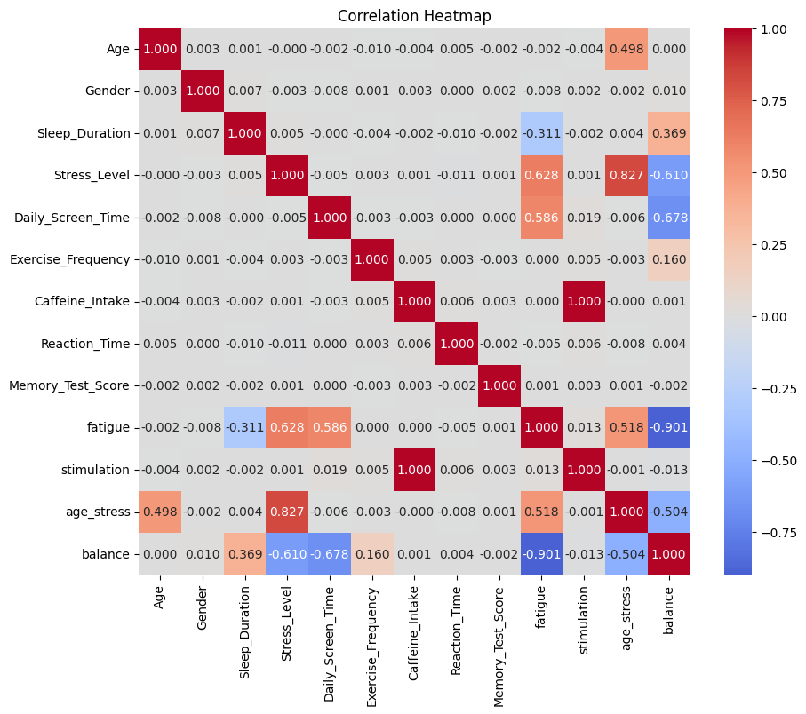
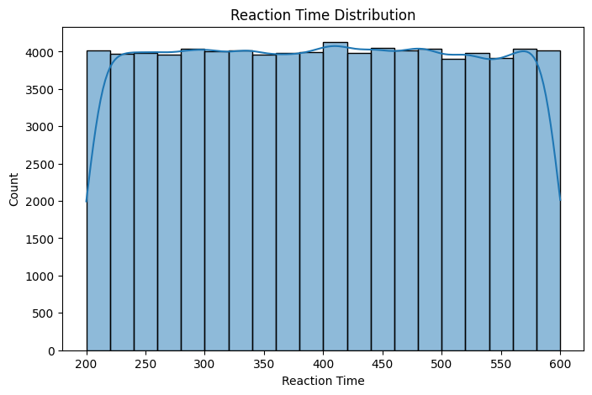
Data Analysis and Insights Visualization
Notes:
Here on the left you can see the correlation heatmap. Notice there are very few strong relationships, and none appear with Reaction Time.
On the right, the histogram shows that reaction time values form a well-distributed range, which is useful for regression models. This combination of weak correlations but strong distribution hinted that linear models might struggle, while non-linear models could still capture subtle patterns.

Slide 8
ML Model
For our machine learning model, we split our data into training and testing and began by cross validating our scores. We found our scores to be near zero, as well as the average mean of our score, which came out to be -0.0001. This validates our suspicions that our data shows no good relationship between our features and reaction time.
We decided to try three different modeling techniques: two linear models, which were linear regression and polynomial regression, and a non-linear model named decision tree regression.
Notes:
We split our dataset and performed cross-validation. The results were close to zero, with an average mean score of –0.0001. This confirmed that our features didn’t strongly relate to reaction time.
We still implemented three models:
Linear Regression
Polynomial Regression
Decision Tree Regression
These gave us a mix of linear and non-linear approaches to compare performance.

Slide 9
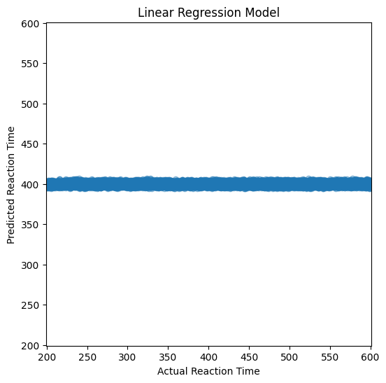
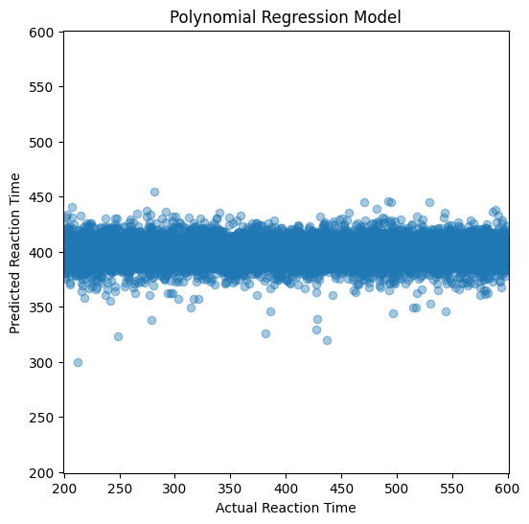
Linear ML Models
Notes:
Our linear regression models ended up with an intercept around 400. Which is the mean of reaction time. That means the model basically predicted the average value regardless of input features.
The coefficients for each feature were almost zero, reflecting how weak those relationships were.
The polynomial model introduced more variation but still struggled.

Slide 10
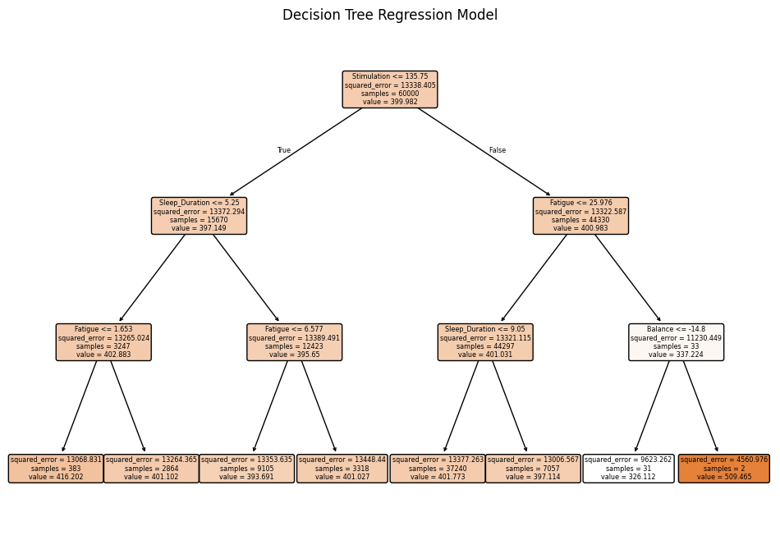
Non-Linear ML Model
Notes:
The decision tree regression produced much more varied predictions, ranging from about 300 to 500 milliseconds. Although this didn’t capture the full range of the dataset, the model performed better because decision trees can identify non-linear relationships.
We limited the depth to avoid overfitting, and deeper trees might have improved accuracy at the cost of generalization.”

Slide 11
Results and Insights
Our linear models shared an intercept of 400, with near-zero coefficients. This means that our linear models struggled to accurately predict Reaction Time.
Our nonlinear model had varying results, from 300 - 500. While this still falls short of our expectations, this was an improvement over our linear models.
We used a depth of 3 in our decision tree, if our depth was higher, our model would’ve had better accuracy. However, due to graph constraints, we stopped at a depth of 3.
Notes:
Our linear models performed poorly because the intercept dominated and feature influence was minimal.
The decision tree performed better because it could model non-linear patterns. Even though our depth was only three layers, it still picked up more structure than linear models.
However, all RMSE values were fairly high, reflecting that none of our features were strong predictors.

Slide 12
Comparison
Our decision tree with a depth of 3 found the lowest RMSE of 98 by traveling through a specific set of nodes. These nodes were Stimulation > 135.75, Fatigue > 25.976, and Balance > -14.8. Because the decision tree worked the best, we could find that our features fit Reaction Time best non-linearly.
Our linear regression model barely outperformed the, scoring a RMSE value of 114.99. This was our simplest model, find coefficients for each feature and an intercept. Because the intercept dominated this graph, all the predictions were close to 400.
Our polynomial regression model performed the worst, scoring a RMSE of 115.32 with a degree of 3. This graph’s predictions varied more than the linear regression, but performed worse.
Notes:
his comparison summarizes our models:
Decision Tree: RMSE = ~98 → Best model
Linear Regression: RMSE = ~115 → Slightly worse
Polynomial Regression: RMSE = ~115.3 → Worst model
The decision tree outperformed the others by identifying splits in features like Stimulation, Fatigue, and Balance. This confirms the data behaves more non-linearly but still doesn’t give us strong predictive power

Slide 13
Conclusion
Due to our near zero correlations as well as our machine learning models showing high RMSE, we can conclude that the features that we used from our data show little to no relation with reaction time.
This means that, given the features we used in our model, we do not have enough data to accurately predict reaction time. If we were to add more features that are commonly associated with reaction time, such as physical performance, cognitive load, as well as improving the features related to sleep, we would ideally have less error when predicting reaction time.
Notes:
In conclusion, our dataset showed extremely weak correlations between our features and reaction time.
All models linear and non-linear had high RMSE values, meaning predictions were not very accurate.
This suggests that the features we had available to us from the dataset are insufficient for predicting reaction time.

Slide 14
References
Bonnar, D., Sangha, L., Roane, B. M., Blum, D. J., Kahn, M., Jang, E., Dunican, I. C., Gradisar, M., & Suh, S. (2022). Evaluation of a Brief Sleep Intervention Designed to Improve the Sleep, Mood, and Cognitive Performance of Esports Athletes. International Journal of Environmental Research and Public Health, 19(7), 4146. https://doi.org/10.3390/ijerph19074146
Caccese, J. B., Eckner, J. T., Franco-MacKendrick, L., Hazzard, J. B., Ni, M., Broglio, S. P., McAllister, T. W., McCrea, M., & Buckley, T. A. (2020). Clinical Reaction-Time Performance Factors in Healthy Collegiate Athletes. Journal of Athletic Training, 55(6), 601–607. https://doi.org/10.4085/1062-6050-164-19
Pavelka, R., Třebický, V., Fialová, J. T., Zdobinský, A., Coufalová, K., Havlíček, J., & Tufano, J. J. (2020). Acute fatigue affects reaction times and reaction consistency in Mixed Martial Arts fighters. PLoS One, 15(1), e0227675. https://doi.org/10.1371/journal.pone.0227675
Wiesing, M., Fink, G. R., & Weidner, R. (2020). Accuracy and precision of stimulus timing and reaction times with Unreal Engine and SteamVR. PLoS One, 15(4), e0231152. https://doi.org/10.1371/journal.pone.0231152
Connaboy, C., LaGoy, A. D., Johnson, C. D., Sinnott, A. M., Eagle, S. R., Bower, J. L., Pepping, G.-J., Simpson, R. J., & Alfano, C. A. (2020). Sleep deprivation impairs affordance perception behavior during an action boundary accuracy assessment. Acta Astronautica, 166, 270–276. https://doi.org/10.1016/j.actaastro.2019.10.029
Harison, Sam (2025). Human Cognitive Performance Analysis. Kaggle. https://www.kaggle.com/datasets/samxsam/human-cognitive-performance-analysis
Luu, A., Winans, A., Suniga, R., & Motz, V. A. (2022). Reaction times for esport competitors and traditional physical athletes are faster than noncompetitive peers. The Ohio Journal of Science, 121(2), 15-20. doi:https://doi.org/10.18061/ojs.v121i2.7677
Bickmann, P., Wechsler, K., Rudolf, K., Tholl, C., Froböse, I., & Grieben, C. (2021). Comparison of Reaction Time Between eSports Players of Different Genres and Sportsmen. International Journal of eSports Research (IJER), 1(1), 1-16. https://doi.org/10.4018/IJER.20210101.oa1
Lauren, Gravitz (2022) How Gamers Actually Sleep. Sleep Foundation. https://www.sleepfoundation.org/sleep-news/how-video-games-affect-sleep-quality-over-time
Kim, H. (2025). An esports edge?. University of Wisconsin La Crosse. https://www.uwlax.edu/news/posts/an-esports-edge

